Slide 1
Database Design

Slide 2
Database Design
Conceptual Design- Provides detailed overview of the enterprise. (ER model)
Logical Design – Deciding on the database schema. Database design requires that we find a “good” collection of relation schemas. (Relational Model)
What attributes should we record in the database?
What relation schemas?
Physical Design – Deciding on the physical layout of the database (the form of file organization and choice of index structures)

Slide 3
The Entity-Relationship Model
Models an enterprise as a collection of entities and relationships
Entity: a “thing” or “object” in the enterprise that is distinguishable from other objects
Described by a set of attributes
Relationship: an association among several entities

Slide 4
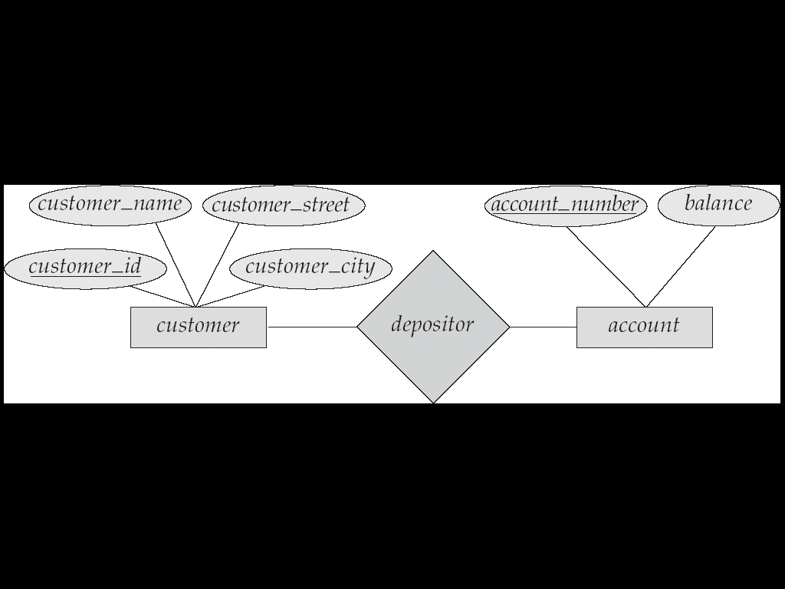
E-R Example
Represented diagrammatically by an entity-relationship diagram

Slide 5
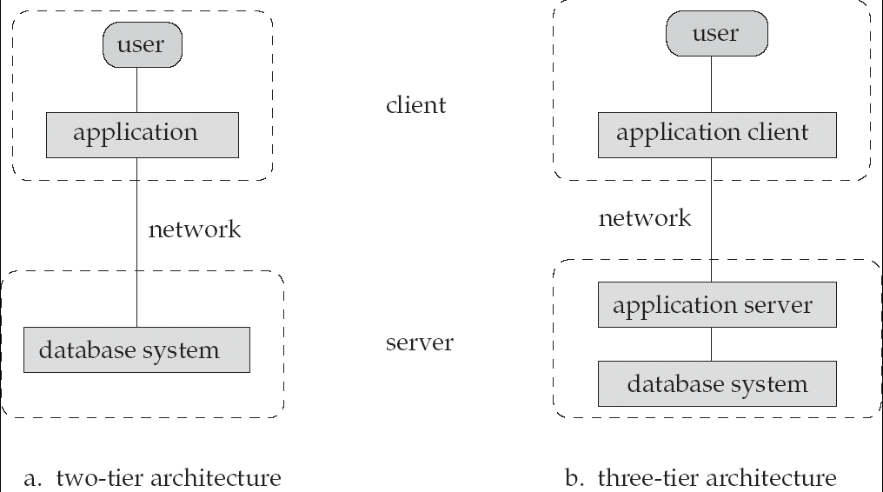
Database Application Architectures
(web browser)

Slide 6
Database Management System Internals
Storage management
Query processing
Transaction processing

Slide 7
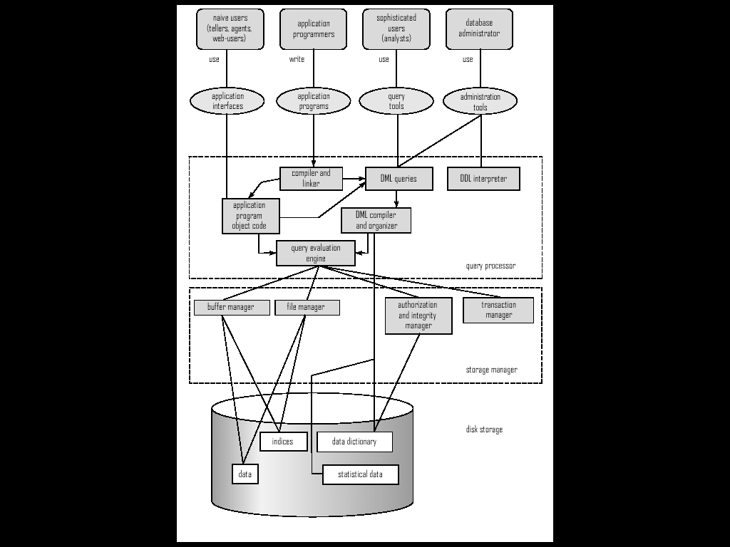
Overall System Structure

Slide 8
Storage Management
Storage manager is a program module that provides the interface between the low-level data stored in the database and the application programs and queries submitted to the system.
It consists of following components:
Buffer manager
File manager
Authorization and integrity manager
Transaction manager

Slide 9
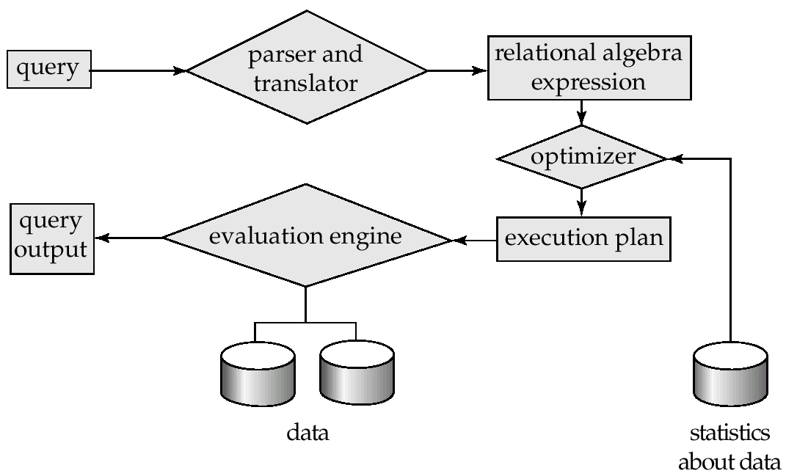
Query Processing
1. Parsing and translation
2. Optimization
3. Evaluation

Slide 10
Query Processing (Cont.)
Alternative ways of evaluating a given query
Equivalent expressions
Different algorithms for each operation
Cost difference between a good and a bad way of evaluating a query can be enormous
Need to estimate the cost of operations

Slide 11
Transaction Management
A transaction is a collection of operations that performs a single logical function in a database application
Transaction-management component
Concurrency-control manager

Slide 12
Database Users
Users are differentiated by the way they expect to interact with the system
Application programmers
Sophisticated users
Specialized users
Naïve users

Slide 13
Database Administrator
Coordinates all the activities of the database system
Database administrator's duties include:
Storage structure and access method definition
Schema and physical organization modification
Granting users authority to access the database
Backing up data
Monitoring performance and responding to changes
Database tuning

Slide 14
Database Architecture
The architecture of a database systems is greatly influenced by the underlying computer system on which the database is running:
Centralized
Client-server
Parallel (multiple processors and disks)
Distributed

